Slide 1
Supermart Grocery Sales – Retail Performance Analysis
Data Analysis & Insights using Python
Tools Used: Python, Pandas, Seaborn, Matplotlib, Google Colab
Prepared by
Pooja Kasabe
UMID-01042527099

Slide 2
Objective
- Analyze grocery sales, profit, and discount trends
1
- Identify top-performing categories, cities, and regions
2
- Recommend business strategies for pricing, marketing, and planning
3

Slide 3
Data Preparation
- Removed duplicate records
- Converted 'Order Date' to datetime format
- Extracted: Order Day, Order Month, Order Year

Slide 4
Techniques & Libraries Used
- Python Libraries: Pandas, NumPy, Matplotlib, Seaborn
- EDA Techniques: Grouping & aggregation, Time series trends, Correlation heatmap, Scatter plots, bar charts, pie charts

Slide 5
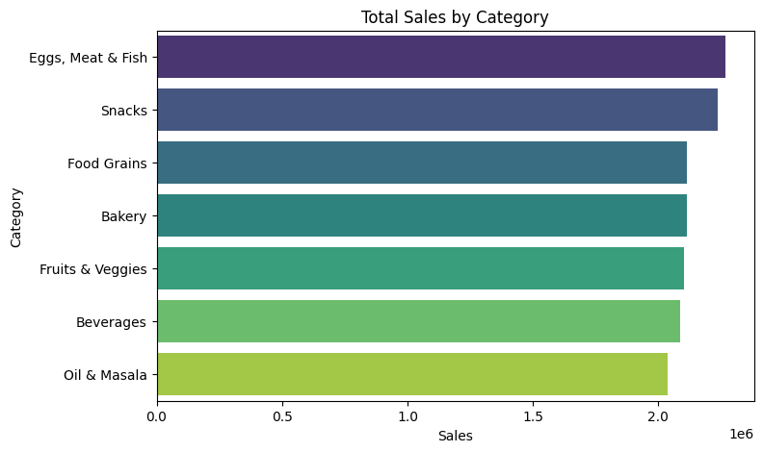
Category-wise Sales
The Eggs, Meat & Fish category contributed the highest to overall sales, followed closely by Snacks and Food Grains.
Beverages and Oil & Masala were among the lower-performing categories in terms of sales volume.
This suggests an opportunity to prioritize high-selling categories in promotions or inventory allocation.

Slide 6
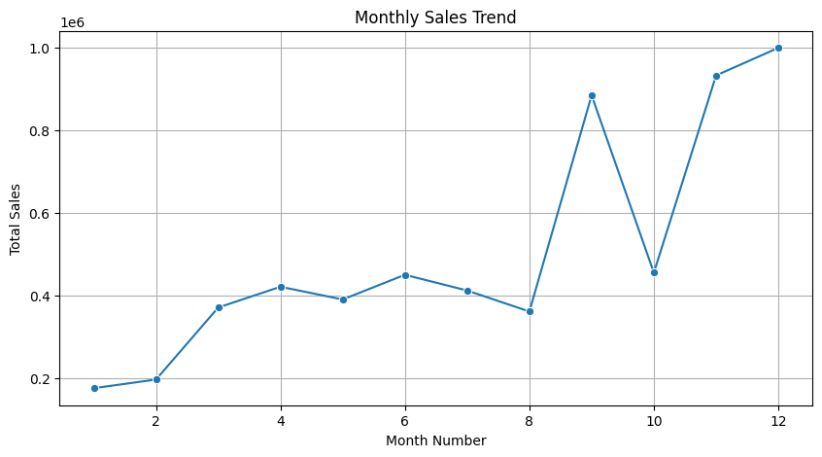
Monthly Sales Trends
- Sales peaked in October–December
- Seasonal trend observed
- Increase inventory/ads before festive season.

Slide 7
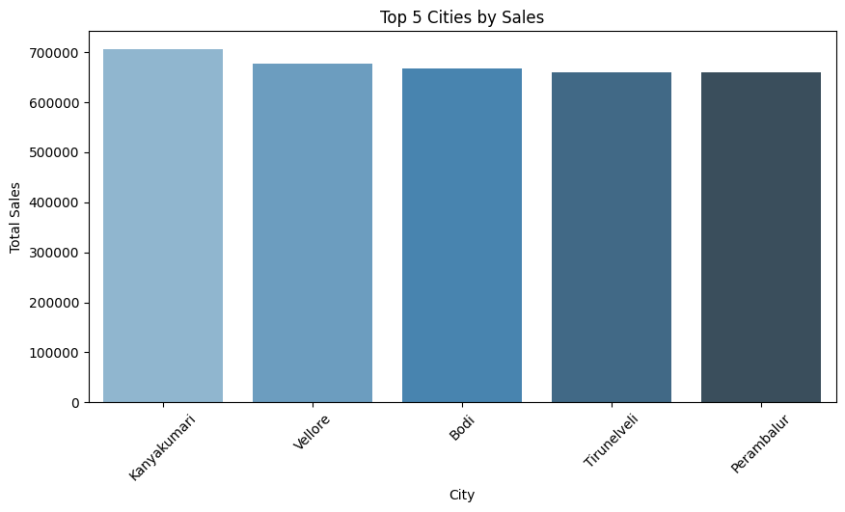
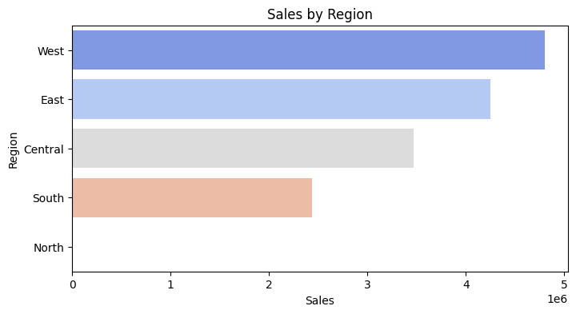
Sales by Region & City
- Kanyakumari, Vellore: Top cities by sales
- Western region leads in total revenue
- Focus on strong regions and explore city-level improvements.
-This highlights opportunities in Tier 2/3 cities and non-traditional regions

Slide 8
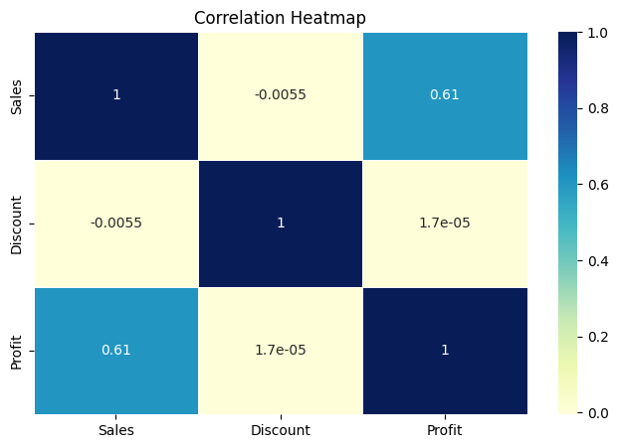
Correlation Heatmap
- Sales & Profit: Strong positive correlation (+0.61)
- Discount shows near-zero correlation
- Discounts don’t always drive more sales or profit
The correlation heatmap confirms a strong positive relationship between sales and profit (0.61), but no meaningful correlation between discount and either sales or profit. This suggests that in this dataset, discounting does not appear to influence sales or profitability in a linear way.

Slide 9
Key Business Insights
The Eggs, Meat & Fish category contributed the highest to overall sales, followed closely by Snacks and Food Grains. Beverages and Oil & Masala were among the lower-performing categories in terms of sales volume. This suggests an opportunity to prioritize high-selling categories in promotions or inventory allocation.
Based on the line chart, October–December had consistently higher sales, suggesting a strong festive season impact. This seasonal surge should be leveraged through campaign planning and supply readiness
Sales and Profit show a strong positive correlation (0.61) — as expected. Discount shows near-zero correlation with both Sales and Profit (~0), meaning it doesn’t drive results significantly in this dataset.
The top cities by sales were Kanyakumari, Vellore, and Bagalkot, not metro cities like Chennai — an important insight. The Western region outperformed others in total revenue. This highlights opportunities in Tier 2/3 cities and non-traditional regions.

Slide 10
Recommendations
Product Strategy
Focus marketing on high-selling items like Eggs, Meat & Fish.
Reassess pricing or bundling for low-performing categories.
Seasonal Planning
Boost stock & promotions before Q4 festive periods.
Discounting
Avoid deep discounts unless they are part of targeted campaigns.
Maintain balanced margins across discount brackets.
Regional Strategy
Invest in Western region and emerging Tier-2/3 cities.
Investigate underperforming areas for tailored interventions.
Continuous Monitoring
Track monthly trends to refine strategy dynamically.

Slide 11

Netflix Content Analysis 2025
A Tableau Story on Global Trends, Viewer Preferences, and Creative Contributions
Prepared by: Pooja Kasabe
UMID: 01042527099

Slide 12
Project Overview
This project analyzes Netflix’s global content using a public dataset.
It explores trends in maturity ratings, genres, content growth, and country-wise contributions.
Dashboards and a story were built using Tableau Public.

Slide 13
Tools & Technologies
Tableau Public (Story & Dashboards)
Python (Pandas, NumPy)
VS Code / Jupyter Notebook
GitHub (for project repository)

Slide 14
Objectives
Explore Netflix's content growth over the years
Analyze maturity ratings and genre distribution
Identify country-wise content trends
Discover director contributions across rating types

Slide 15
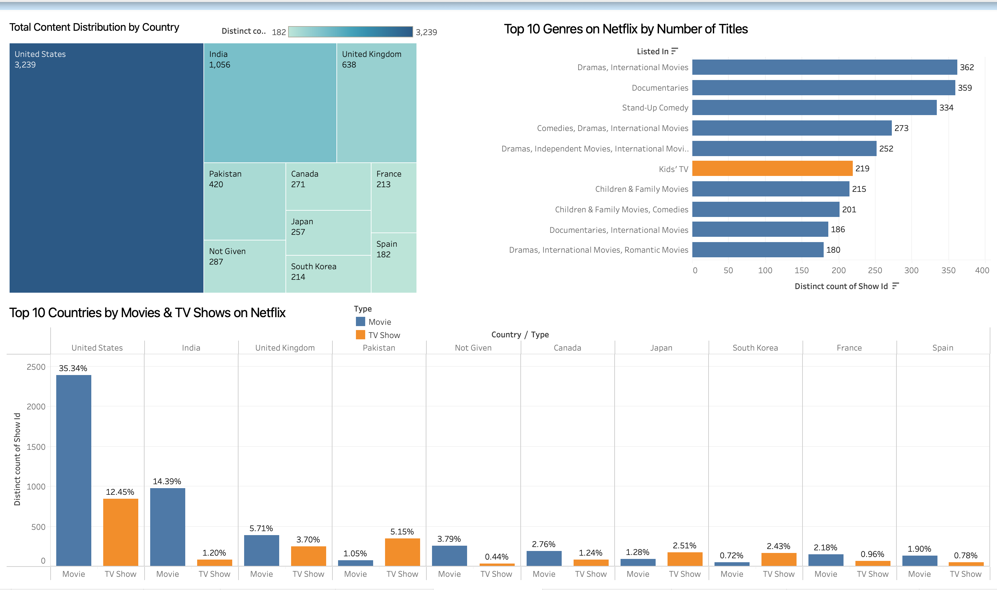
Dashboard 1: Global Footprint and Genre Landscape
USA and India lead in movie production
Pakistan ,Japan & South Korea show strong TV show presence
Dominant genres include Dramas, Documentaries, international movies & Comedies

Slide 16
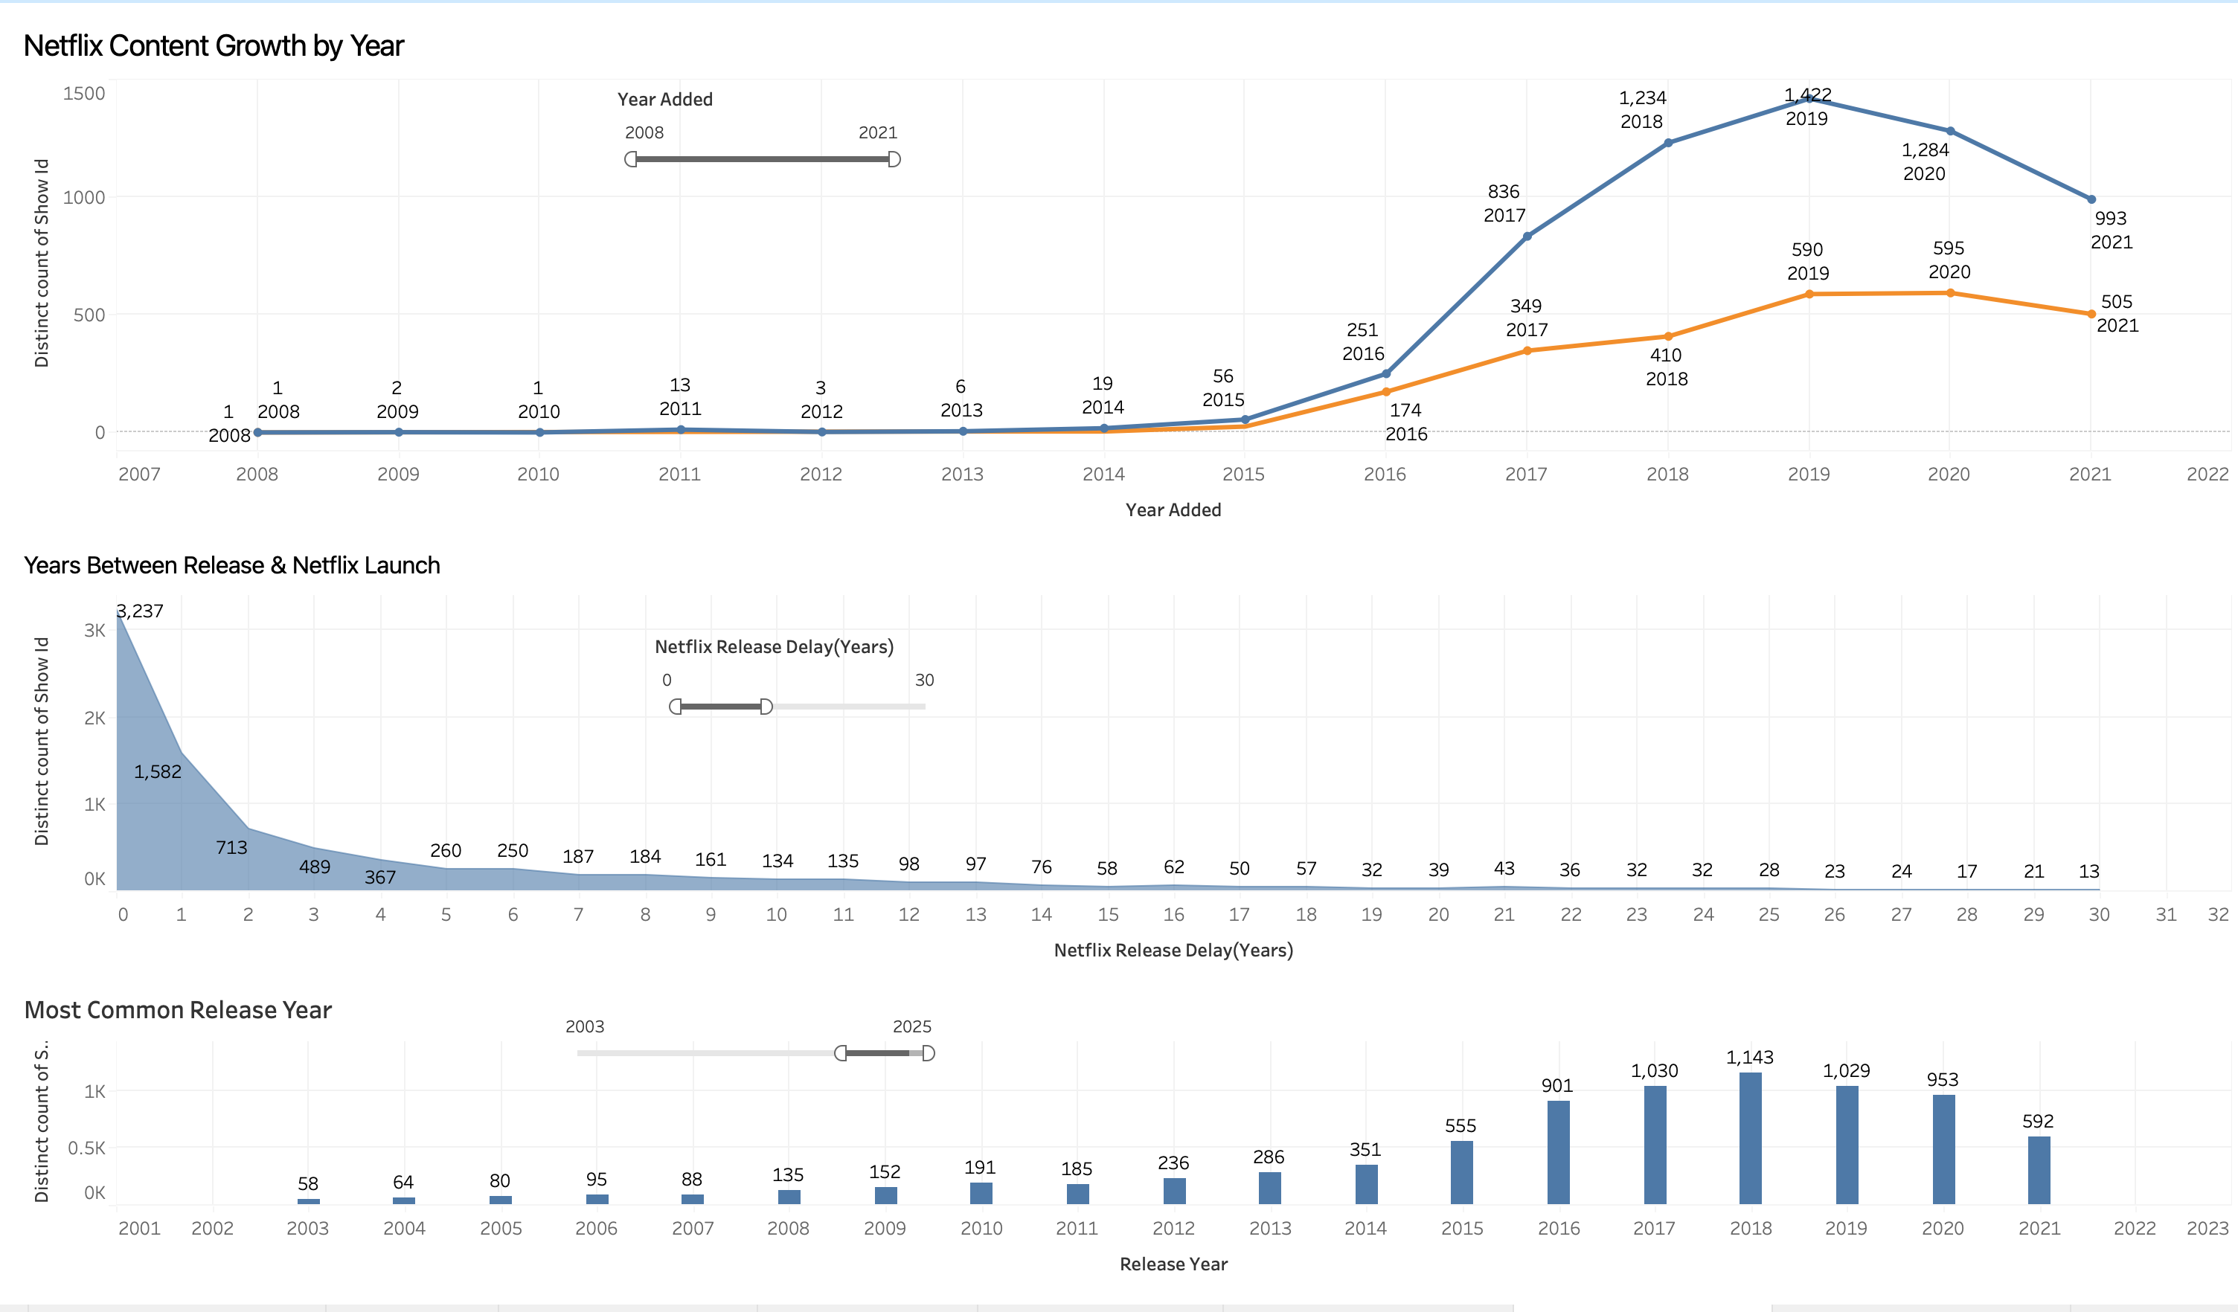
Dashboard 2: Content Expansion & Catalog Strategy
COVID-19 Effect: During the pandemic, people stayed home, leading to a surge in OTT consumption. To meet rising demand, Netflix boosted its content additions, especially in 2020.
Content Boom (2018–2020): Netflix’s catalog expanded rapidly, peaking in 2019–2020 due to global growth and aggressive acquisition strategies.
Same-Year Prioritization: Despite many back-catalog additions, a large portion of content is still added in the same year as its original release, indicating a parallel focus on timely content delivery.

Slide 17
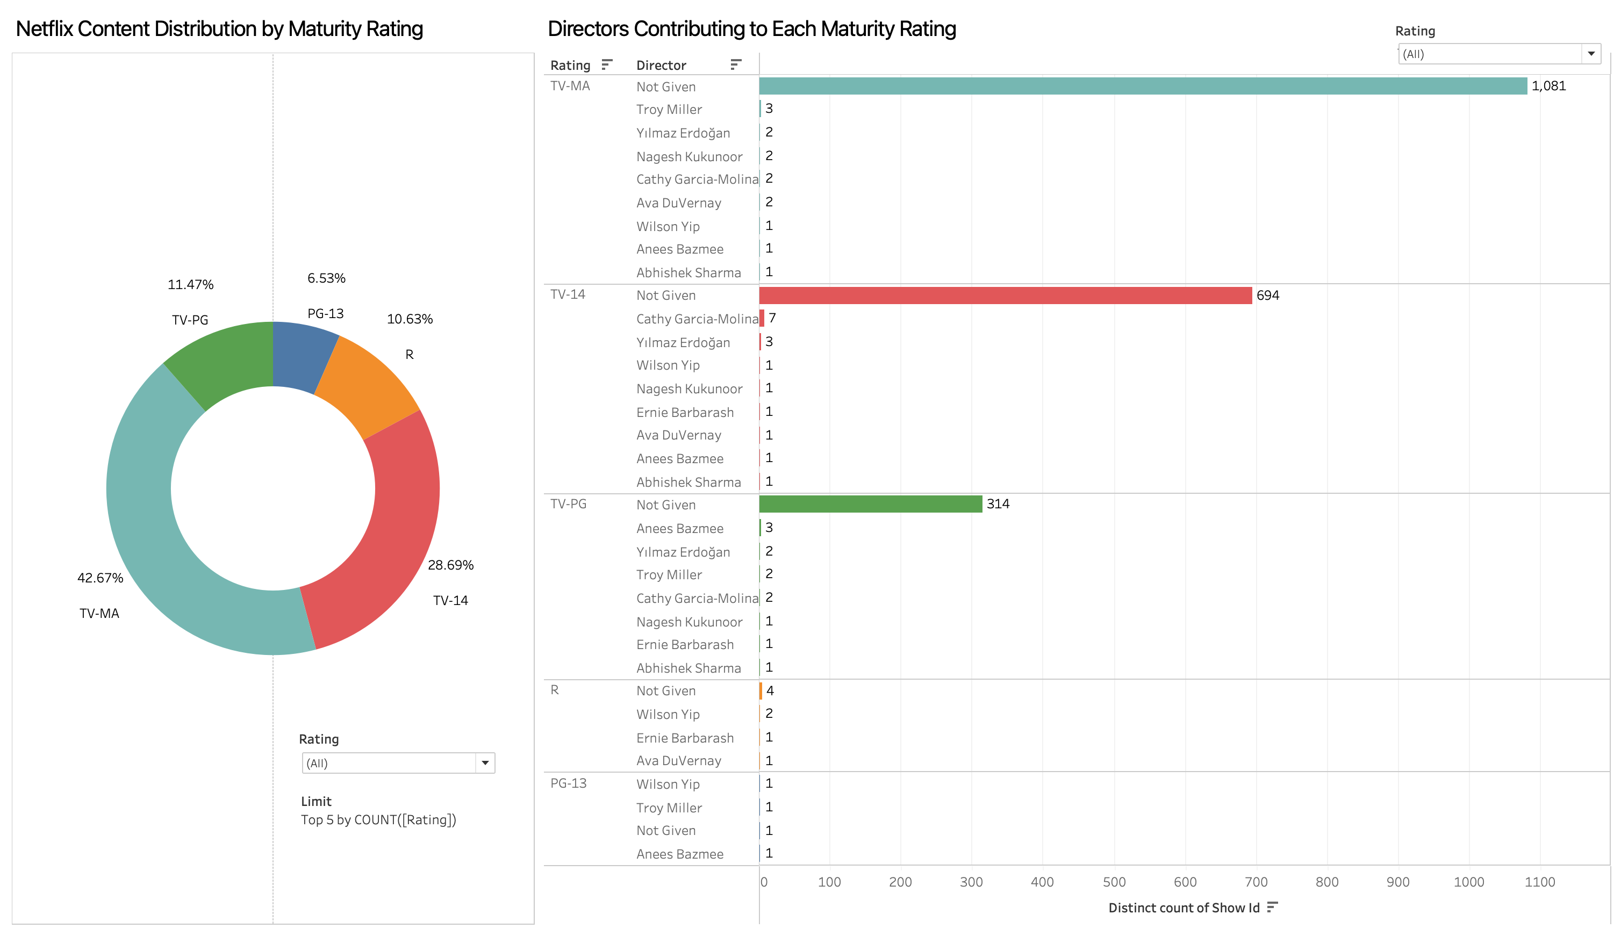
Dashboard 3: Viewer Maturity Preferences
TV-MA (42.67%) and TV-14 (28.69%) dominate
Troy Miller leads TV-MA content, Cathy Garcia-Molina for TV-14
Large number of titles missing director metadata

Slide 18
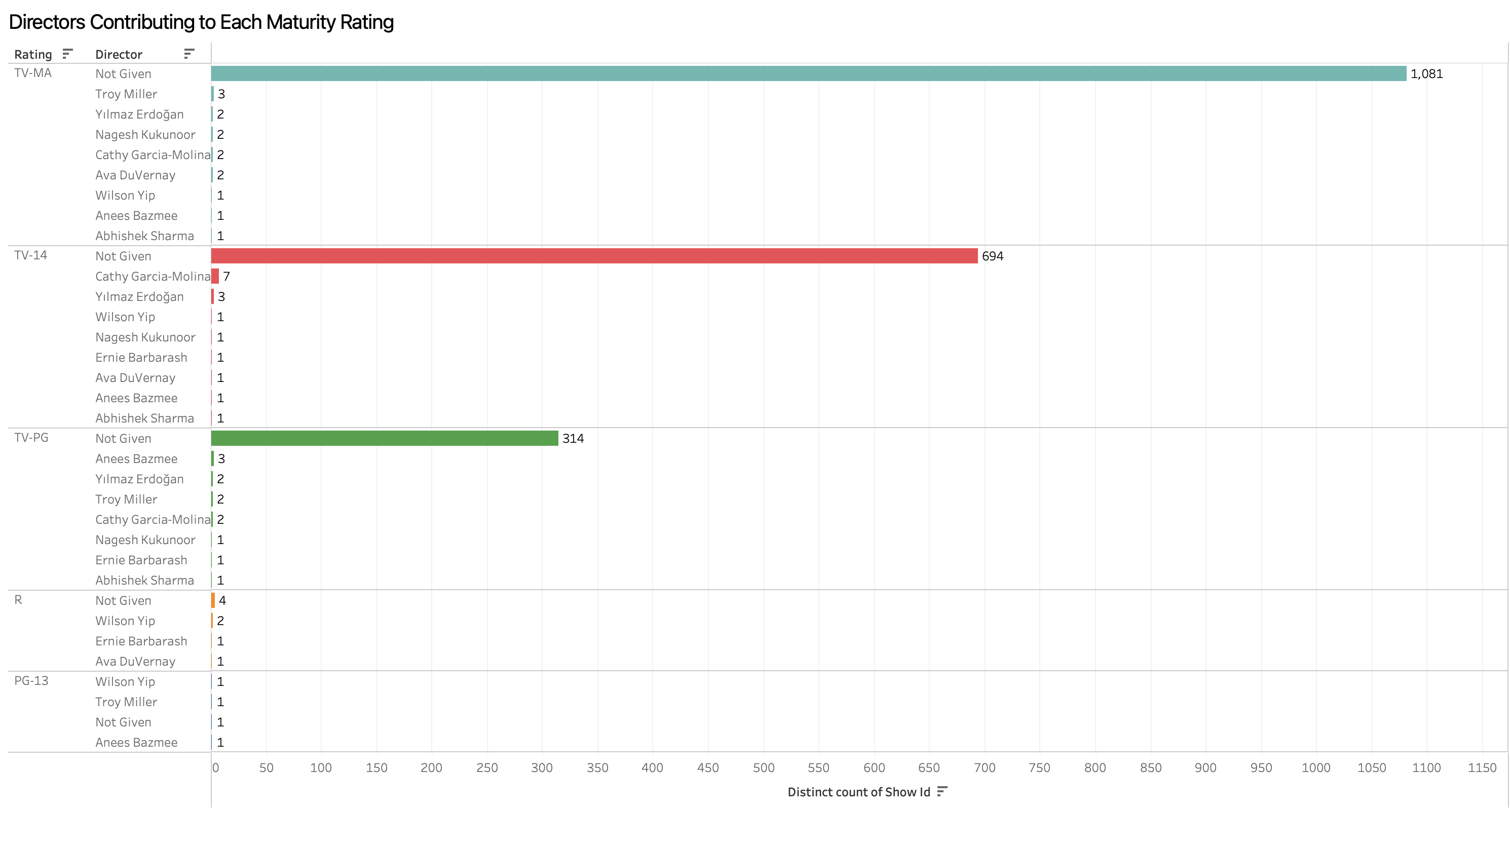
Dashboard 4: Directors & Maturity Ratings
Netflix’s content library focuses heavily on mature and teen audiences.
Top contributors by rating:
TV-MA (Adults Only) -:Troy Miller
TV-14 (Teens & Above) :Cathy Garcia-Molina
TV-PG (Family Friendly) : Anees Bazmee
“Not Given” director tags highlight metadata gaps for several shows, especially in TV-MA and TV-14.

Slide 19
Key Insights
Netflix favors mature-rated content (TV-MA, TV-14)
Back-catalog licensing plays a key role in growth
Genre and rating strategies vary by country
Top directors contribute to targeted rating categories

Slide 20
Recommendations
Prioritize mature-rated and globally appealing content
Improve metadata completeness (director names)
Focus on TV show content from emerging countries
Balance originals with licensed titles for strategic expansion

Slide 21
Thank You
For evaluation purposes, please refer to the Tableau Public link shared.
https://public.tableau.com/app/profile/pooja.kasabe/vizzes

Slide 22

Coffee Sales Analysis (2024)
A Data Visualization Project by Pooja Kasabe

Slide 23
Objective
• Analyze sales trends, coffee preferences, and customer behavior
• Identify top performing products and buyer patterns

Slide 24

Tools & Technologies
• Tools: Python, Pandas, Seaborn, Matplotlib, Google Colab

Slide 25
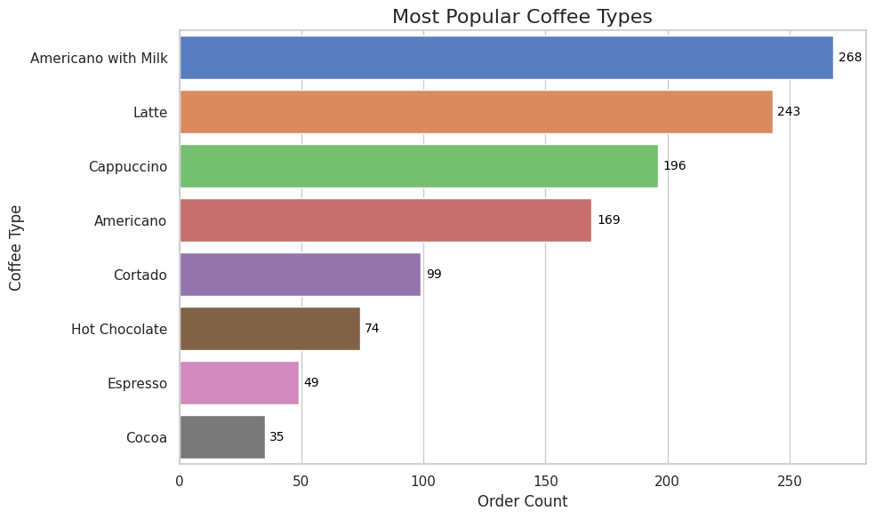
Most Popular Coffee Types
Key Insights:
Americano with Milk tops the list with 268 orders, making it the most loved coffee.
Latte (243 orders) and Cappuccino (196) also show strong popularity.
Cocoa and Espresso are least ordered, suggesting niche or occasional demand.
Trend indicates a preference for milk-based premium coffees.

Slide 26
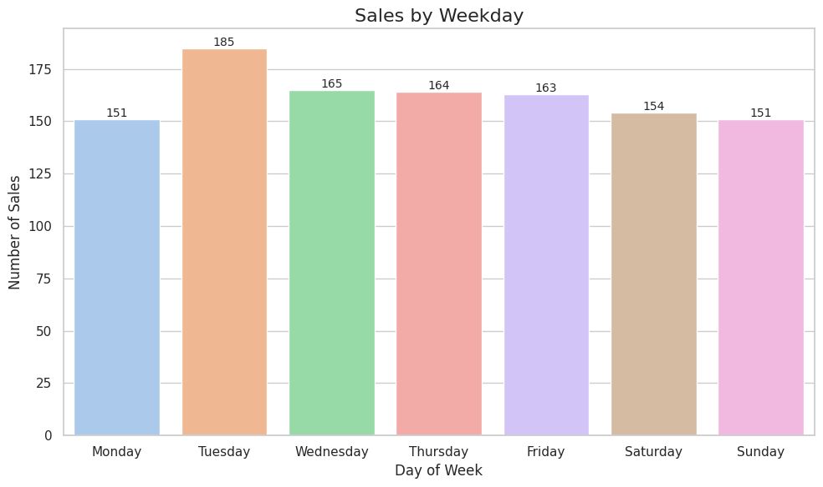
Sales by Weekday
Key Insights:
Tuesday had the highest number of transactions (185), making it the busiest sales day.
Weekday sales (Tue–Fri) remained consistently high, indicating strong midweek demand.
Monday and Sunday recorded the lowest sales (151), suggesting lower footfall at the start and end of the week.

Slide 27
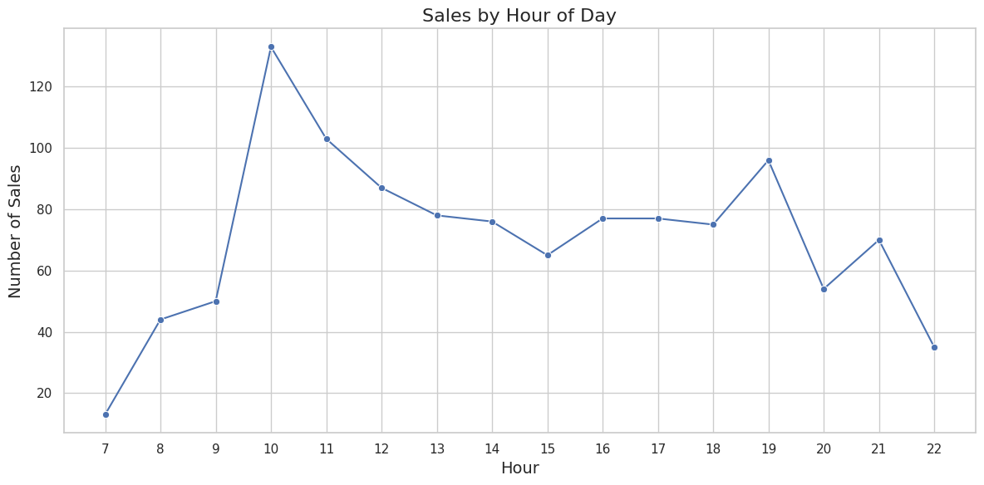
Hourly Sales Trend
Key Insights:
10 AM sees the highest sales spike, indicating a strong morning coffee rush.
Sales gradually decline post-lunch and stabilize in the evening hours.
Secondary peak observed around 7 PM, likely due to evening coffee breaks.
Lowest sales occur at 7 AM and 10 PM, outside typical coffee hours.

Slide 28
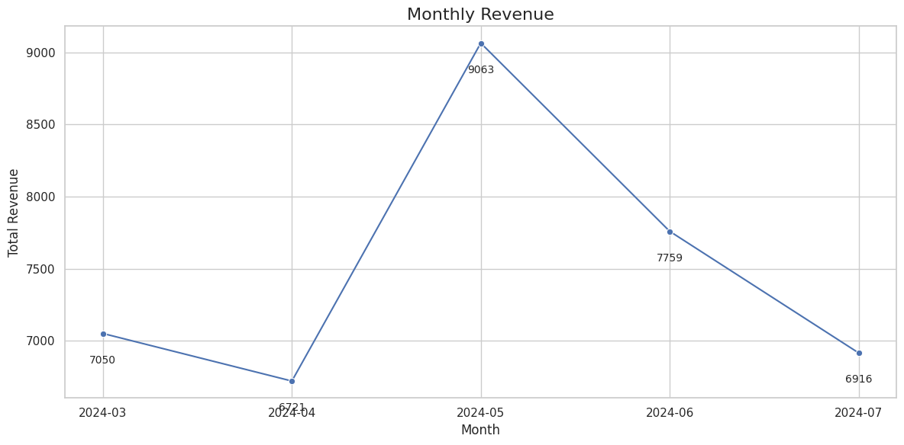
Monthly Revenue
Key Insights:
May recorded the highest revenue at ₹9063 — a clear monthly peak.
Revenue dropped in July to ₹6916, the lowest among all months.
March and April had steady but lower performance, indicating seasonal demand boost in May.

Slide 29
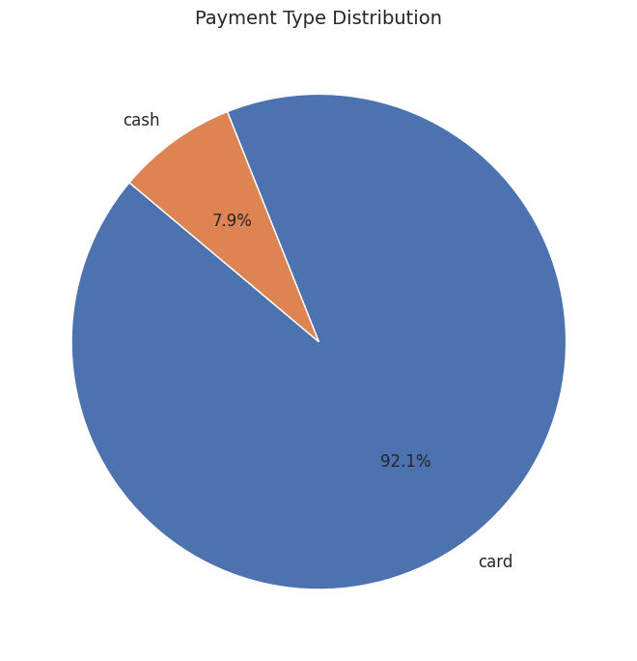
Payment Method Insights
Key Insights:
Card payments dominate the transactions with a 92.1% share.
Cash is used rarely, accounting for only 7.9% of all payments.
Indicates a strong preference for digital transactions, possibly due to convenience, rewards, or promotions.

Slide 30
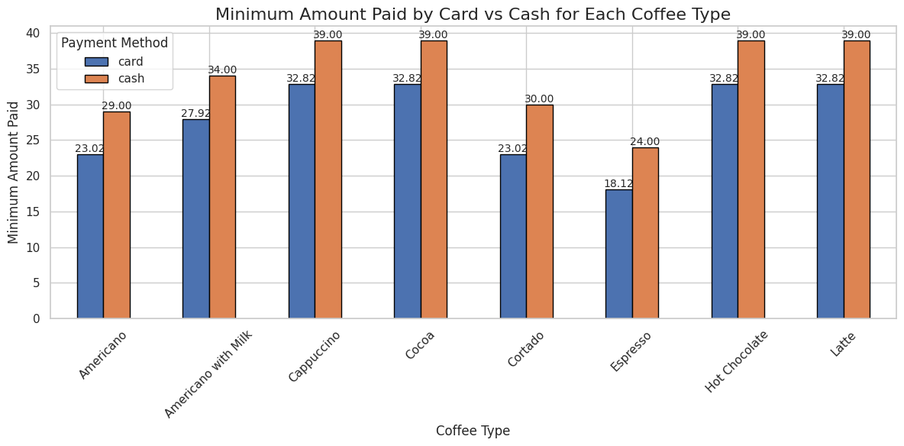
Price Comparison: Card vs Cash
Key Insights:
Card payments are consistently cheaper for most coffee types.
Espresso and Americano show the highest savings when paid by card (₹5–₹7).
Premium drinks like Latte, Cappuccino, Hot Chocolate, and Cocoa show ₹6.18 higher minimum price when paid in cash (₹39.00) compared to card (₹32.82).
Indicates possible digital payment incentives or rounding-up in cash payments.

Slide 31
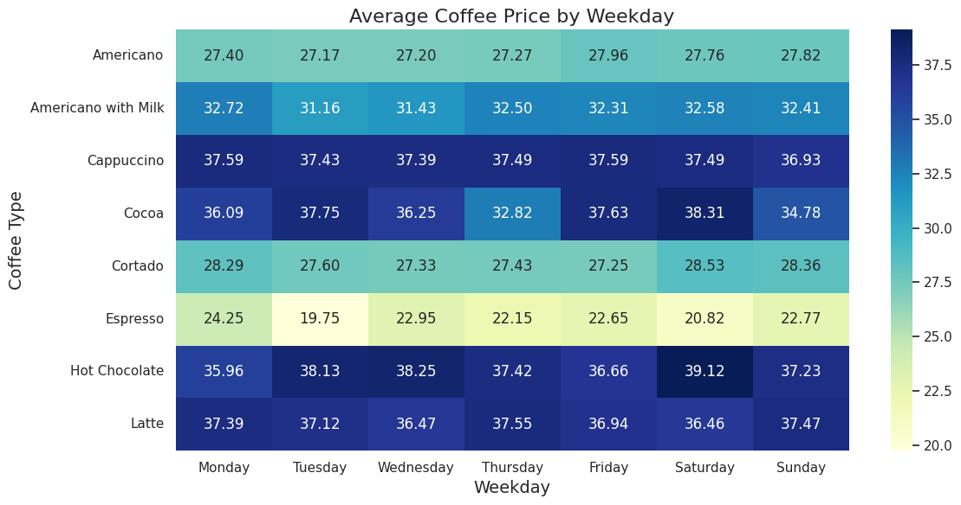
Price Drop by Weekday
Key Insights:
Tuesday shows the lowest average price for Espresso (₹19.75) — possibly a midweek offer.
Wednesday still shows moderately low prices for several types, including Cortado and Americano.
Cocoa and Hot Chocolate peak on Saturday, possibly due to weekend demand.
Latte prices remain stable across the week with minor fluctuations.

Slide 32
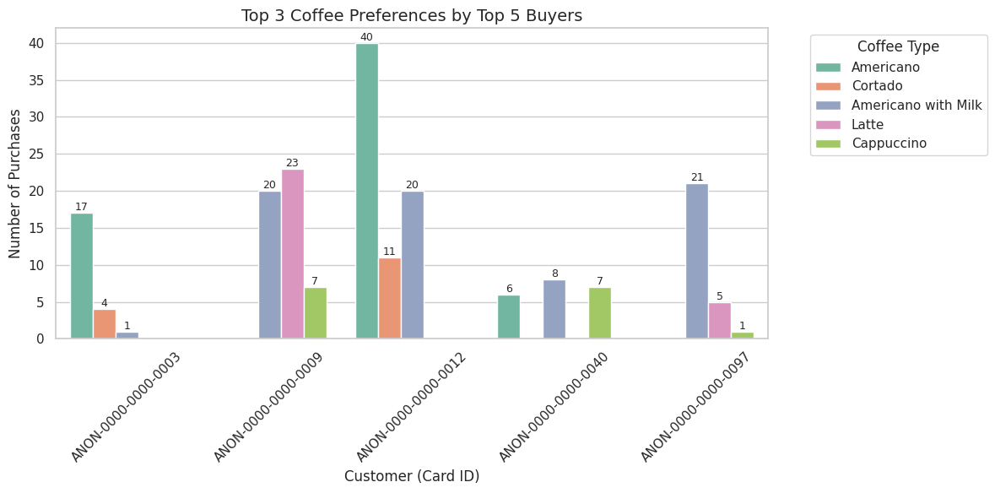
Top Buyers’ Preferences
Key Insights:
Each top buyer showed clear loyalty to 2–3 specific coffee types.
Americano and Americano with Milk were most preferred across buyers.
Buyer AMON-0000-0000-0009 showed strong preference for Latte (23 purchases).
Buyer AMON-0000-0000-0012 made 40+ Americano purchases — highest among all.

Slide 33
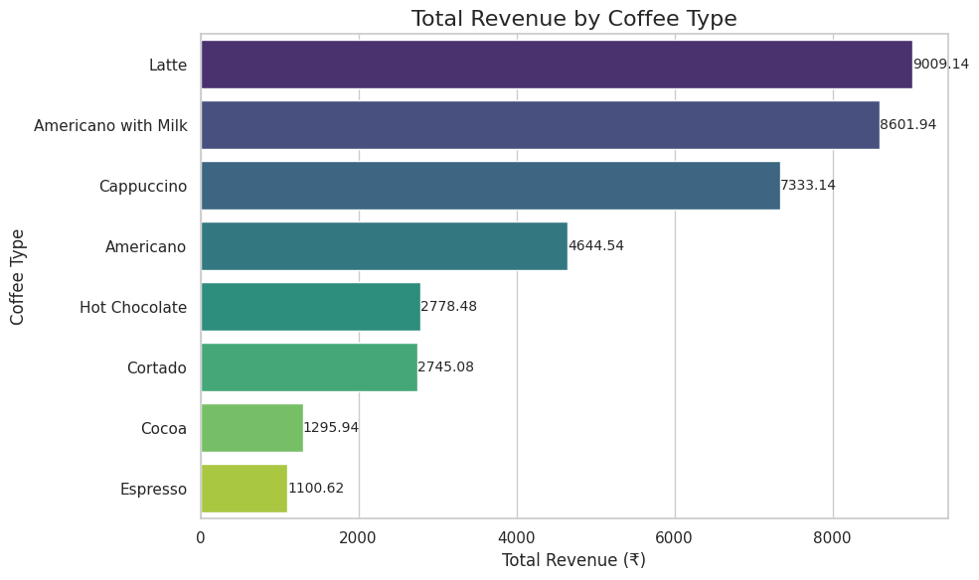
Revenue by Coffee Type
Key Insights:
Latte, Americano with Milk, and Cappuccino were the top revenue drivers.
Latte alone generated ₹9009, the highest among all.
Espresso and Cocoa contributed least to total revenue, under ₹1300 each.
Suggests a preference for premium coffee among buyers.

Slide 34

Key Insights
Americano with Milk is the most popular drink across all buyer categories.
10 AM and Tuesdays show the highest sales volume.
Card payments dominate over cash, indicating a tech-savvy customer base.
Midweek (Wednesday) prices tend to dip, possibly indicating promotional pricing or lower demand.
Top 5 buyers maintain consistent preferences, suggesting customer loyalty and habitual purchasing behavior.
Recommendations
Promote combo offers or discounts on Americano with Milk to increase upselling.
Run special campaigns or flash sales on Tuesdays around 10 AM to boost peak-time sales.
Encourage more customers to use card payments through loyalty rewards or cashback offers.
Explore midweek promotional pricing strategies to increase traffic on low-demand days.
Consider personalized marketing for top buyers based on their consistent order history.

